Slide 1

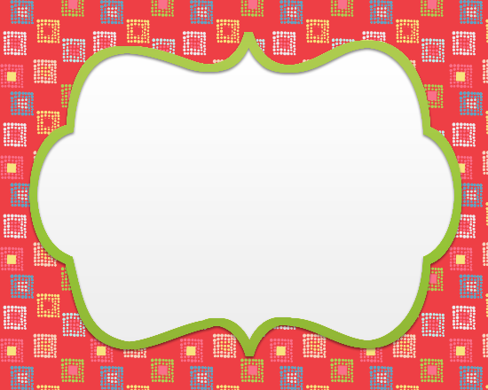
4x2
Tissue Paper
2.5x2
Rulers
Sharpies
Blank
Bookmarks
Fabric
Markers

Slide 2
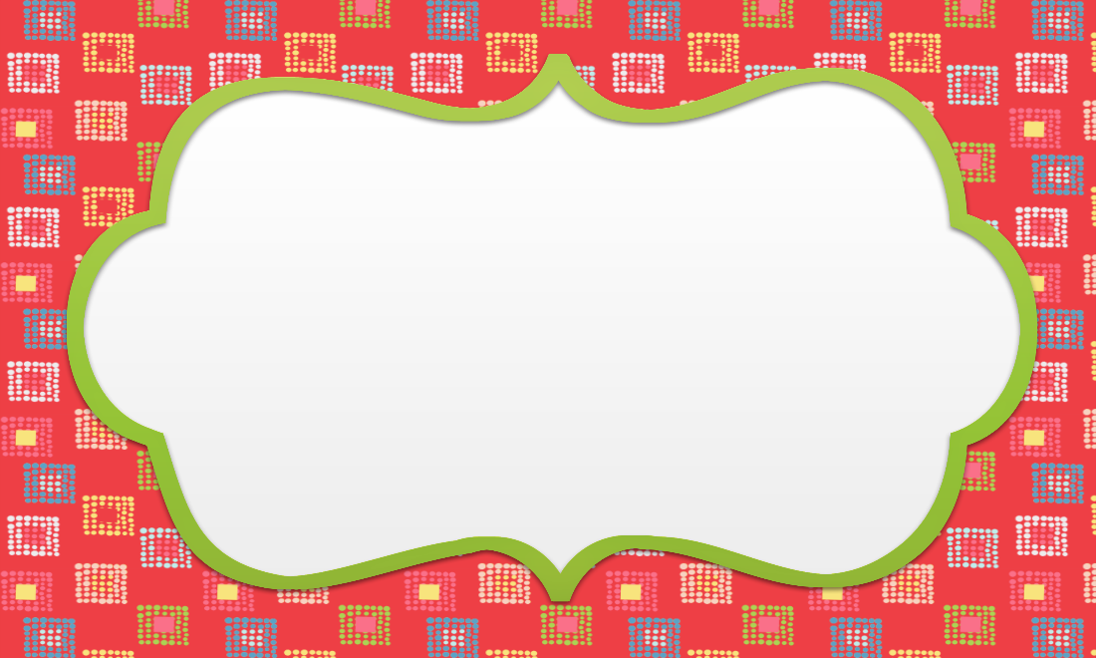
5x3
Cardboard
Tubes
Glue/Tape
Fasteners
Sphero

Slide 3
5x3
Cardboard
Yarn
Recycled
Containers

Slide 4

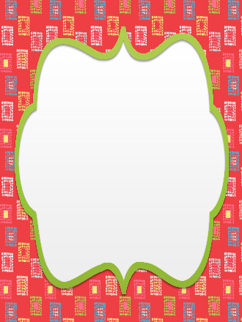
3x1
Popsicle
Sticks
Cotton Balls/
Pom-Poms
Pipe
Cleaners
Popsicle
Sticks
Bottle
Caps
Straws
Scissors/
Hole Puncher
Paint
2x3
Googly
Eyes

Slide 5

2x3
Fabric
Fabric
Markers
Pencils
Erasers

